Slide 1
Software Development 3
Inheritance Revision

Slide 2
Inheritance
Inheritance allows you to create a new class based on an existing class
Inheritance allows a class (subclass/child class) to inherit data and methods from another class (superclass/base class/parent class)
A subclass inherits all the characteristics of the superclass, but can also add its own characteristics.

Slide 3
Inheritance
A facility to introduce a specialisation or extension of an existing class, specifying only how the new class differs from the existing class.
Inheritance means existing classes can be reused in different applications
Inheritance provides a way to make use of existing classes
Test for inheritance:
Current Account IS A Bank Account

Slide 4
Inheritance
Inheritance relationships are shown in a UML class diagram using a solid arrow with an unfilled triangular arrowhead pointing to the parent class
Vehicle
Car
Proper inheritance creates an is-a relationship, meaning the child is a more specific version of the parent

Slide 5
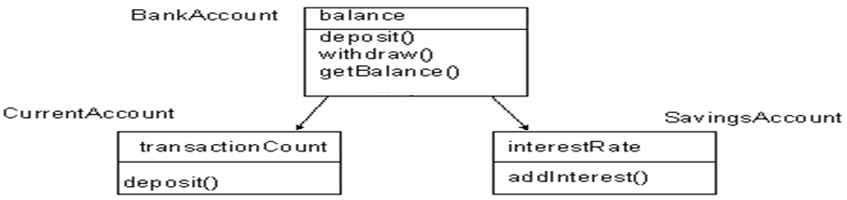
Example: How Inheritance works
CurrentAccount and SavingsAccount are special types of BankAccount
BankAccount is the super type or super class of CurrentAccount and SavingsAccount
CurrentAccount and SavingsAccount are the sub types or sub classes of the super class BankAccount.

Slide 6
Inheritance
The more general class is called the super class (BankAccount),
The more specialised class is called the sub class (CurrentAccount, SavingsAccount).
The sub class is said to inherit from the super class.
A derived class automatically has all the instance variables and methods that the base class has, and it can have additional methods and/or instance variables as well
Remember private member is private to the class that defines it ( and that class only).
Note that in Java, every class implicitly inherits from a super class called Object

Slide 7
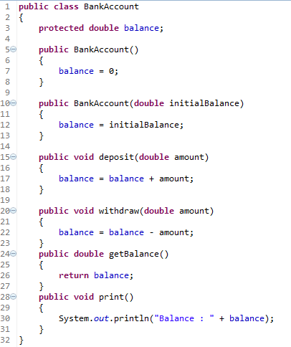
Inheritance Example
BankAccount.java

Slide 8
ConstructorOverloading
BankAccount class provided two methods with the same name (both constructors)
The methods have the same name, but different signatures
note the signature of a method is given by the first line, excluding the return type if any
BankAccount()
BankAccount(double initialBalance)
The name of the method is said to be overloaded
Java can tell which method to call based on the methods signature

Slide 9
The protected Modifier
Visibility modifiers affect the way that class members can be used in a child class
Variables and methods declared with private visibility cannot be referenced in a child class
They can be referenced in the child class if they are declared with public visibility -- but public variables violate the principle of encapsulation
There is a third visibility modifier that helps in inheritance situations: protected

Slide 10
The protected Modifier
The protected modifier allows a child class to reference a variable or method in the child class
It provides more encapsulation than public visibility, but is not as tightly encapsulated as private visibility
A protected variable is also visible to any class in the same package as the parent class (more on packages later)

Slide 11
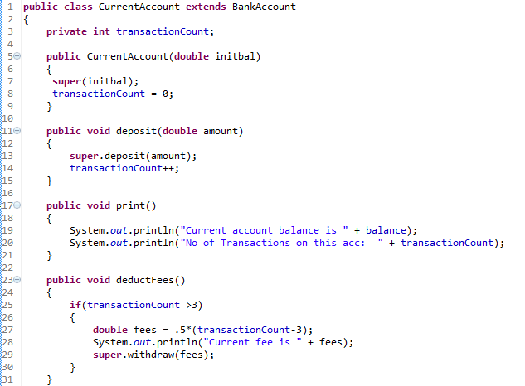
Inheritance Example
CurrentAccount.java
No need to use
a getter()
method here

Slide 12
Inheritance
Looking at the code in more detail this code introduces the following:
the extends keyword
the super() method used to called the superclass constructor
A subclass can call the constructor of a parent to perform initialisation on those variables for which the parent is responsible.

Slide 13
Overloading Methods
Overloading means
having multiple methods with the same name
but different signatures in the same class
they define a similar operation in different ways for different data.
How a particular Shape object is drawn is dependent on whether the Shape is a Line, a Circle or a Square
//Signatures of the draw method in the Shape class
draw(Circle c); // draw a circle
draw(Square s); // draw a square
draw(Line l); // draw a line
The draw method is overloaded
The version of the method that is called is dependent on the parameter passed.

Slide 14
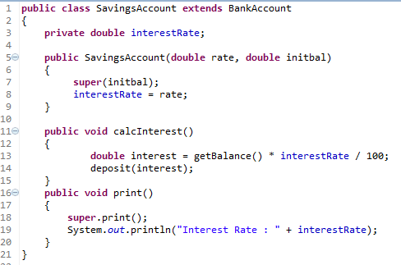
Overriding Methods
SavingsAccount.java

Slide 15
Overriding Methods
A child class can override the definition of an inherited method in favour of it’s own. Note the print() method in the SavingsAccount class
actually calls the print() method in the superclass.
Java IS able to tell the difference between
the inherited method and
the one we define directly in the super class
i.e. the print( ) method SavingsAccount class will OVERRIDE the print( ) method inherited from the superclass BankAccount .
Note the super keyword used to call the print() method of the superclass
However SavingsAccount print( ) calls
the print method of it superclass and ALSO
adds its own extra behaviour

Slide 16
Overriding Versus Overloading
Do not confuse overriding a method in a derived class with overloading a method name
When a method is overridden, the new method definition given in the derived class has the exact same number and types of parameters as in the base class
When a method in a derived class has a different signature from the method in the base class, that is overloading
Note that when the derived class overloads the original method, it still inherits the original method from the base class as well

Slide 17
The Class Object
The class Object is in the package java.lang which is always imported automatically
Having an Object class enables methods to be written with a parameter of type Object
A parameter of type Object can be replaced by an object of any class whatsoever
For example, some library methods accept an argument of type Object so they can be used with an argument that is an object of any class

Slide 18
The Class Object
The class Object has some methods that every Java class inherits
For example, the equals and toString methods
Every object inherits these methods from some ancestor class
Either the class Object itself, or a class that itself inherited these methods (ultimately) from the class Object
However, these inherited methods should be overridden with definitions more appropriate to a given class
See the 2nd example in the sample programs

